Slide 1
Lesson 7: Natural Language Processing

Slide 2
Today's Agenda
Bag of words
Term frequency inverse document frequency
Jaccard distance
Information retrieval
Sentiment analysis
Topic modeling

Slide 3
Learning Objectives
Use a bag-of-words representation for text.
Use term frequency - inverse document frequency values to represent text
Use Jaccard distance to measure the similarity between two documents.
Use TF-IDF to retrieve the most relevant documents for a query.
Apply classification models for sentiment analysis.
Use topic model predictions as additional features for classification.

Slide 4
Overview of NLP
Human natural language is a commonly encountered unstructured data type
NLP seeks to extract information from and model human natural language
Various estimates of what percent of ML solutions use NLP methods Take estimates with a grain of salt
About 70% of web data is natural language
In 2019 Gartner group claims 50% of analytical queries involve NLP
NLP is part of daily life for many people

Slide 5
Motivation: Harnessing Big Text Data
Internet
News
Literature
Blogs Knowledge Many applications
Email
Twitter
Personal assistants
Etc.
Gaining Intuition:
I’m given a task. What approach will work?

Slide 6
Overview of NLP
In this lesson we focus on natural language processing NLP attempts to model or process natural language
The goal of NLP is classification, prediction, and simple generation
The machine does not actually have any understanding of meaning
NLP is a form of weak AI
We will not address natural language understandingNLU is a form of strong AI
For strong AI, the machine must actually understands the meaning of what is being said and what it is saying
NLU is the basis of the famous Touring test
NLU is a research frontier

Slide 7
Why is NLP hard?
Human language is imprecise
Computer languages have strict grammar and semantics
Human languages use loose grammars and ambiguous semantics, at best
Example; I ask an intelligent agent ‘do you know what time it is?’, what answer do I expect?
Yes. –The agent does know the time
It is 10:45. –The answer I wanted
Example; But, if I say, ‘Tell me what time it is.’, the answer is unambiguous
A human would not notice a semantic ambiguity between these cases

Slide 8
Main approaches in NLP
Rule-based methods
Regular expressions
Context free grammar
Probabilistic modelling and machine learning
Linear classifiers
Likelihood maximization
Deep Learning
CNN, RNN, LSTM, etc.

Slide 9
Examples (rule-based methods)
Semantic slot filling
Context free grammar
Parsing

Slide 10
Examples (traditional ML based methods)
Training corpus (with some markups)
Feature engineering
- Is the word capitalized?
- What are the previous words?
- etc…
Define a Probabilistic graphical model
Conditional Random Field: p(tags|words)

Slide 11
Some useful libraries and tools
NLTK
Small but useful datasets with markup
Preprocessing tools: normalization, tokenazition, etc.
Pre-trained models for parsing, POS-tagging, etc.
spaCy: python and cython library for NLP
Gensim: python library for text analysis (word embedding, topic modelling, etc.)

Slide 12
Text classification
Example: sentiment analysis
Input: text of review
Output: class of sentiment (e.g. positive vs negative)
Positive example:
The movie was great with likeable characters
The mayor has done a splendid job in revitalizing the downtown
Negative example:
The worst performance by Actor John Doe, no wonder the film bombed
Don’t buy this product, run for your wallets!

Slide 13
Organization of text data
We organize text data in a corpus
A corpus is a collection of documents
What constitutes a document?
Most any unit of text can be a document for NLP
An entire book, a chapter from a book, a paragraph, or a single sentence
Email, text message, or tweet
Blog post
Tweet
Movie review
A contract
Instructions to assemble my new office chair
…

Slide 14
Text preprocessing
What is text?
Sequence of words
What is a word?
A single distinct meaningful element of speech or writing, used with others (or sometimes alone) to form a sentence and typically shown with a space on either side when written or printed (Ref: Oxford dictionary).
Input: The dog ate the fish, then took a nap.
Output: The dog ate the fish then took a nap

Slide 15
Text preprocessing
German has some compound words which are written without space
rindfleischetikettierungsüberwachungsaufgabenübertragungsgesetz
that's 63 letters long meaning "the law for the delegation of monitoring beef labeling.”
In Chinese there are no spaces at all!
如果你能看懂这句话那么你的中文很厉害！

Slide 16
Text Preparation
Text data is messy
Considerable preprocessing typically required
Be careful! Make sure you do not remove the parts you need!
Normalize text
Stop words are removed
Stemming to represent forms of a word as same token
Limit vocabulary to remove bias from rare words
Document is tokenized

Slide 17
Text Preparation
Text Normalize prevents creation of spurious tokens
Example; for sentence:
Is this the right way to solve the problem?
We do not want a token ‘problem?’
Steps of text normalization can include
All characters to lower case –‘Shovel’ and ‘shovel’ are same token
Remove punctuation
Remove numbers and special characters
Several possible pitfalls
Should the punctuation be removed in words like ‘can’t’?
Some numbers can be important tokens
How should dates be handled?

Slide 18
Tokenization
Process that split an input sequence into tokens
Tokens are useful unit for semantic processing (can be a word, sentence, paragraph, etc.)
Example:

Slide 19
Token normalization
Process of canonicalizing tokens so that matches occur despite superficial differences in the character sequences of the tokens
Dog, dogs dog
Wife, wives wife
Stemming
A process of removing and replacing suffixes to get to the root form of the word, called a stem
Lemmatization
return the base or dictionary form of a word, which is known as the lemma

Slide 20
Example (stemmer)
Rule Example
SSES → SS caresses → caress
IES → I ties → ti
SS → SS caress → caress
S → cats → cat
Problem: fails on irregular forms & produces non words
Notes:
Ref: https://www.nltk.org/_modules/nltk/stem/porter.html

Slide 21
Example (lemmatization)
WordNet lemmatizer
Uses the WordNet database to lookup lemmas
churches → church dogs → dog
Wolves → wolf maximum → maximum
Problem: not all words are reduced
Notes:
Takeaway: we need to try stemming or lemmatization and choose depending on use case.

Slide 22
Stemming Vs. Lemmatization
When to use what!
If you need speed, then use stemming
If you have time, then use lemmatizers as it scans a corpus
If you are building a language application, then use lemmatization to ensure match to root forms.

Slide 23
Tokens to features
Most common ways to extract numerical features from text content
tokenizing strings and giving an integer id for each possible token, for instance by using white-spaces and punctuation as token separators.
counting the occurrences of tokens in each document.
normalizing and weighting with diminishing importance tokens that occur in the majority of samples / documents.
Ref: http://scikit-learn.org/stable/modules/feature_extraction.html

Slide 24
Tokens to features
Most common ways to extract numerical features from text content
tokenizing strings and giving an integer id for each possible token, for instance by using white-spaces and punctuation as token separators.
counting the occurrences of tokens in each document.
normalizing and weighting with diminishing importance tokens that occur in the majority of samples / documents.
In this scheme, features and samples are defined as follows:
each individual token occurrence frequency (normalized or not) is treated as a feature.
the vector of all the token frequencies for a given document is considered a multivariate sample.
A corpus of documents can thus be represented by a matrix with one row per document and one column per token (e.g. word) occurring in the corpus.

Slide 25
Tokens to features
Great instructor
Not a great instructor
Do not like
great | instructor | not | a | do | like
1 | 1 | 0 | 0 | 0 | 0
1 | 1 | 1 | 1 | 0 | 0
0 | 0 | 1 | 0 | 1 | 1
Limitations:
Word orders is lost hence BOW cannot capture phrases and multi-word expressions
BOW model doesn’t account for potential misspellings or word derivations.

Slide 26
Tokens to features
N-grams
Instead of building a simple collection of unigrams (n=1), one might prefer a collection of bigrams (n=2), where occurrences of pairs of consecutive words are counted.
Great instructor | instructor | Do not | a | Not like | …
1 | 1 | 0 | 0 | 0 | …
1 | 1 | 0 | 1 | 0 | …
0 | 0 | 1 | 0 | 1 | …
Great instructor
Not a great instructor
Do not like

Slide 27
Tokens to features
Reduce the number of features in n-grams
High frequency n-grams (e.g. stop words)
Low frequency n-grams (e.g. typos)
Medium frequency n-grams are usually good n-grams
Problem: If we were to feed the direct count data directly to a classifier very frequent terms would shadow the frequencies of rarer yet more interesting terms. Therefore we need to re-weight the count features into floating point values suitable for usage by a classifier

Slide 28
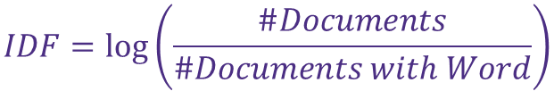
Tokens to features
Text Frequency: Word frequency or TF
Count how many times a word appears in a single document.
Terms that occur in fewer documents are more descriptive and may contain more information (Rarity matters).
Inverse Document Frequency (IDF)
Inverse of the proportion of documents containing term in the whole collection.
#documents / #documents with word might be too severe.
A word appearing twice instead of once shouldn’t have twice the impact
Maybe we should tie these together:
TF-IDF: Rare terms in whole collection that appear frequently in some documents maybe very important!
Multiply these two
$$IDF=log⁡\left(\frac{\#Documents}{\#Documents with Word}\right)$$

Slide 29
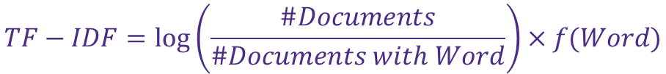
How to Use TF-IDF
Finding important words to describe the document collections or subgroups of collections.
Using the count of important words as a feature in a model.
Using the distribution of a document’s TF-IDF values.
Characterize writing styles
Comparing authors
Determining original authors
Finding plagiarism
$$TF−IDF=log⁡\left(\frac{\#Documents}{\#Documents with Word}\right)×f(Word)$$

Slide 30
Example

Slide 31
Document classification
Document classification is a common NLP application
Many applications of document classification
Organize articles; sport, business, local, weather,…
Organize books; romance, mystery, business, science,…
Detect SPAM emails
Determine sentiment in reviews and social media
Detect language a document is written in
…

Slide 32
Notebook Time

Slide 33
Language modeling
Assign a probability to a sentence
Why?
Machine translation (e.g. P(the average probability) > P(the mean probability))
Spell correction (e.g. P(I’m enjoying this class) > P(I’m enjoiing this class))
Speech recognition (e.g. P(I’m gonna take a walk)> P(am gonna take a wok)
Handwriting recognition
Etc.

Slide 34

Language modeling
Compute the probability of a sentence or sequence of words
$p\left(w\right)=p\left(w1,w2,…,wn\right)$
Compute the probability of an upcoming word
$p\left(w4|,w1,w2,w3\right)$
A model that computes either of these $p\left(w\right)$ or $p\left(wn|,w1,w2,…,w_{n−1}\right)$ is called a language model.

Slide 35
Example
Toy corpus
This is the house that Jack built.
This is the malt
That lay in the house that Jack built.
This is the rat,
That ate the malt
That lay in the house that Jack built.
This is the cat,
That killed the rat,
That ate the malt
That lay in the house that Jack built.
What is P(house | this is the) ?

Slide 36

Example
$p\left(house | this is the\right)= \frac{c(this is the house)}{c(this is the …)}=\frac{1}{4}$
$p\left(Jack | that\right)= \frac{c(that Jack)}{c(that …)}=\frac{4}{10}$

Slide 37

Language modeling intuition
Predict probability of a sequence of words
$w=(w1w2…wk$)
Chain rule:
$p\left(w\right)=p\left(w1\right)p\left(w2 | w1\right)…p(wk|{w1w2…w}_{k−1})$
Markov assumption:
$p\left(wi | w1…w_{i−1}\right)=p(wi|w_{i−n+1}…w_{i−1})$

Slide 38

Bigram language model
For $n=2$
$p\left(w\right)=p\left(w1\right)p\left(w2 | w1\right)…p(wk|w_{k−1})$
Example:
This is the malt
That lay in the house that Jack built
$p\left(this is the house\right)=p\left(this\right)p\left(is | this\right)p(the|is)(p(house|the)$

Slide 39

Bigram language model summarized
Define the model
$p\left(w\right)=\prod_{i=1}^{k+1}{p(wi|w_{i−1}})$
Estimate the probabilities:
$p\left(w_{i} | w_{i−1}\right)=\frac{c(w_{i−1}w_{i})}{\sum_{wi}{c(w_{i−1}w_{i})}}=\frac{c(w_{i−1}w_{i})}{c(w_{i−1})}$

Slide 40

N-gram language model summarized
Define the model
$$p\left(w\right)=\prod_{i=1}^{k+1}{p(wi|}w_{i−n−1},…,w_{i−1})$$

Slide 41

How to train n-gram models
Log-likelihood maximization:
$logp\left(wtrain\right)=\sum_{i=1}^{N+1}{logp(wi|w_{i−n−1},…,w_{i−1})}$
$=p(wi|w_{i−n+1}^{i−1})$
Estimates for parameters:
$p\left(wi | w_{i−n+1}^{i−1}\right)=\frac{c(w_{i−n+1}^{i})}{\sum_{wi}{{c(w}_{i−n+1}^{i})}}=\frac{c(w_{i−n+1}^{i})}{c(w_{i−n+1}^{i−1})}$
Where $N$is the length of the train cor pus.

Slide 42
Example Generated Shakespeare
Accuracy increases as N increases
Train various N-gram models and then use each to generate random sentences.
Example Corpus: Complete works of Shakespeare
Unigram: To him swallowed confess hear both. Which. Of save on trail for are ay device and rote life have.
Bigram: What means, sir. I confess she? Then all sorts, he is trim, captain.
Trigram: Fly, and will rid me these news of price. Therefore the sadness of parting, as they say, ‘tis done.
Quadrigram: King Henry. What! I will go seek the traitor Gloucester. Exeunt some of the watch.

Slide 43
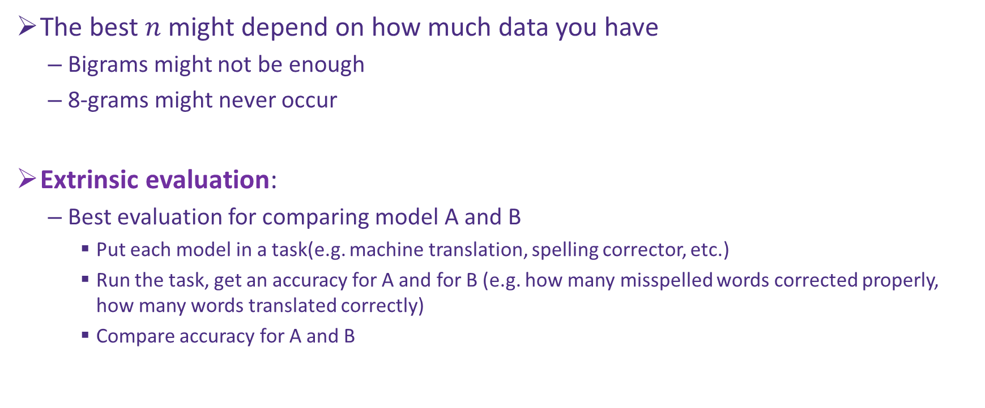
Evaluating Language Models
The best $n$ might depend on how much data you have
Bigrams might not be enough
8-grams might never occur
Extrinsic evaluation:
Best evaluation for comparing model A and B
Put each model in a task(e.g. machine translation, spelling corrector, etc.)
Run the task, get an accuracy for A and for B (e.g. how many misspelled words corrected properly, how many words translated correctly)
Compare accuracy for A and B

Slide 44
Evaluating Language Models
Extrinsic evaluation:
Time-consuming (can take days, weeks, etc.)
How to address that?
Use intrinsic evaluation: perplexity
Perplexity is the inverse of the probability of the test set (as assigned by the language model), normalized by the number of word tokens in the test set.

Slide 45

Evaluating Language Models
Likelihood:
$$L=p\left(Wtest\right)=\prod_{i=1}^{N+1}{p(wi|}w_{i−n−1},…,w_{i−1})$$
Perplexity:
$$P={p\left(Wtest\right)}^{−\frac{1}{N}}=\frac{1}{\sqrt[N]{p\left(Wtest\right)}}$$
$N is the length of the test corpus.$
$minimizing perplexity=maximizing probability!$

